Slide 1
Kevin Kelly
CEO
Travel Nunavut

Slide 2
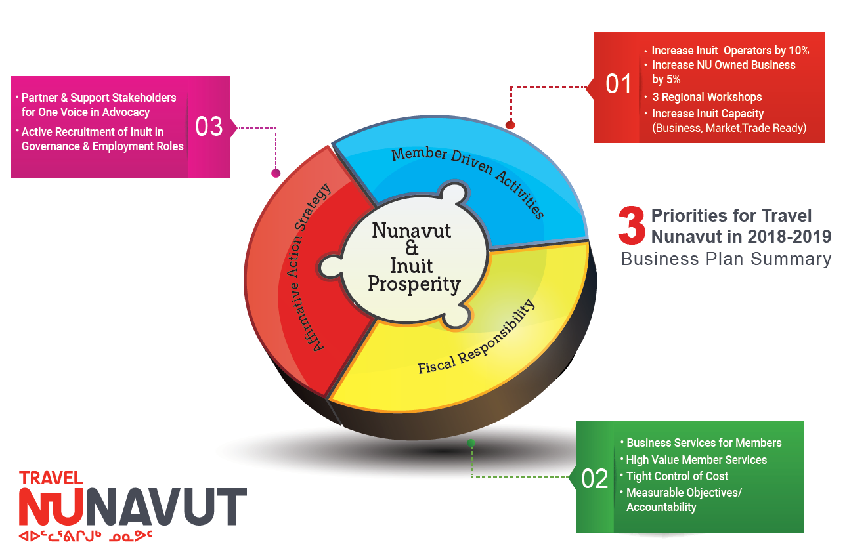

Slide 3
Board Structure
Board made up of industry representation all have voting privileges
Arts Sector
Cruise Sector
Accommodation Sector
Transportation Sector
Travel Trade Sector
Hunting / Fishing Sector
Three Regional Representatives
One Kitikmeot Region Sector
One Kivalliq Region Sector
One Qikiqtani Region Sector
One representative from each of the RIA
Kitikmeot Inuit Association
Kivalliq Inuit Association
Qikiqtani Inuit Association

Slide 4
Member Driven Activities

Slide 5
Put page 23 Annual report

Slide 6
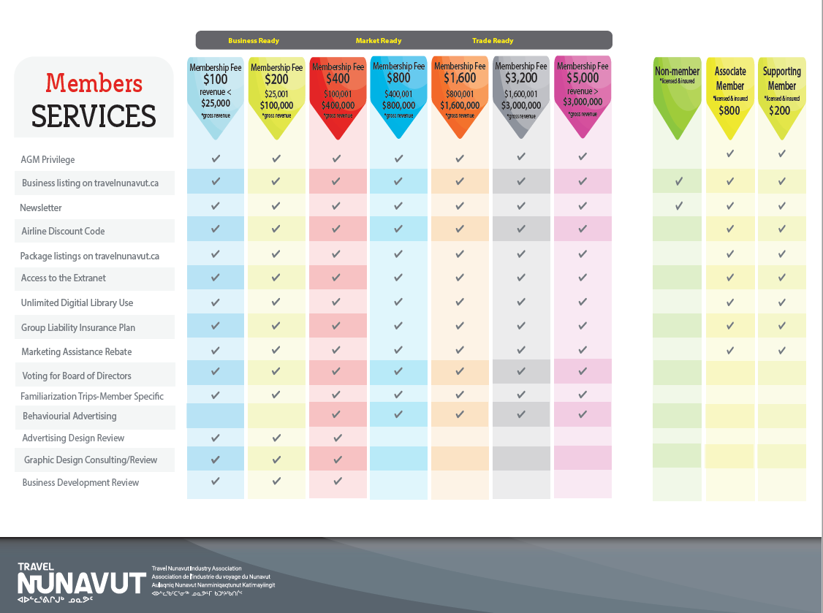
2019/2020
Fees are reviewed annually by the Board of Directors

Slide 8
Workshops 2018/2019
52 Inuit operators trained
Rankin Inlet
Baker Lake
Arviat
Iqaluit
Kimmirut
Qikiqtarjuaq
Pangnirtung
Cambridge Bay

Slide 9
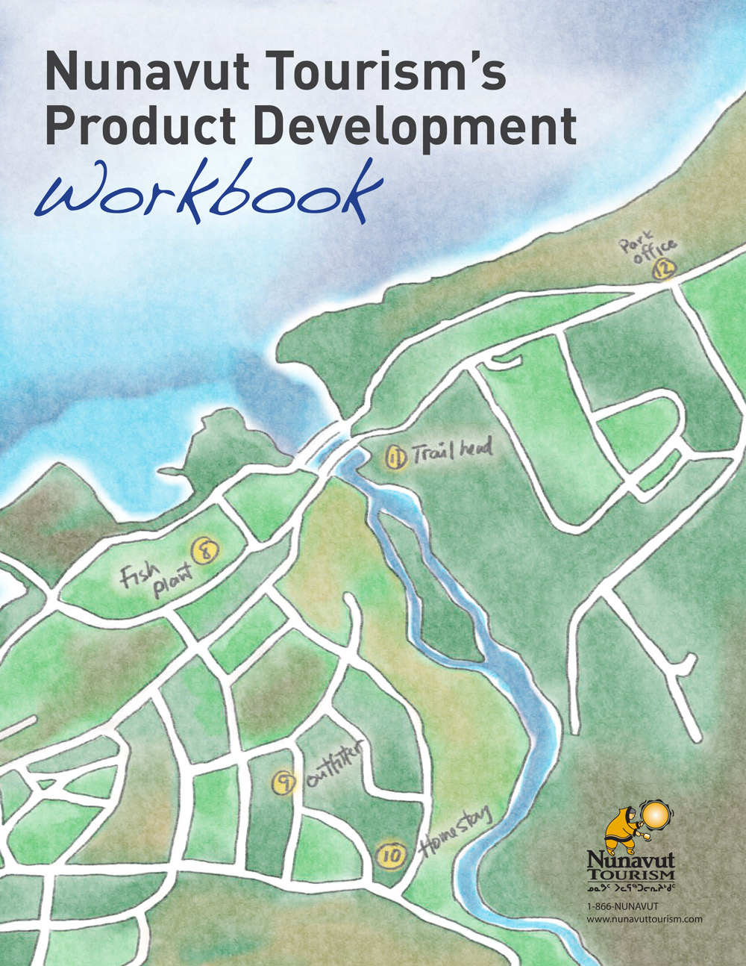
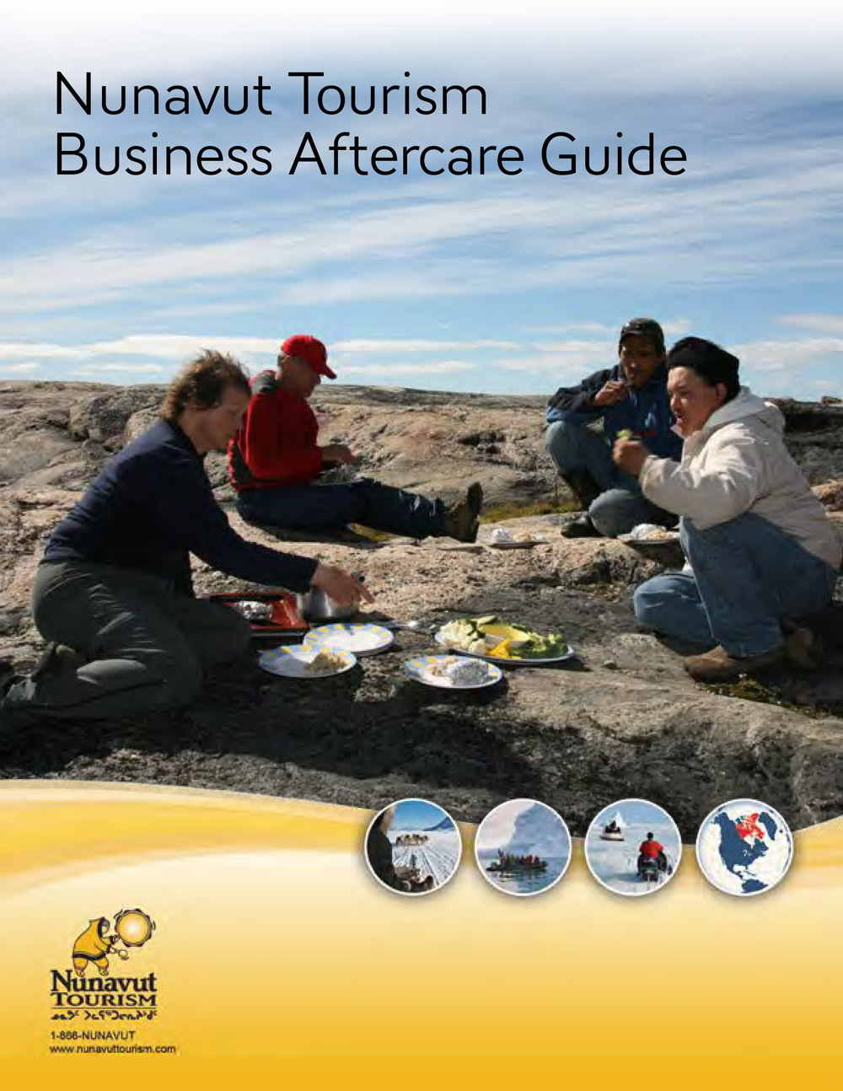
Workshops

Slide 10
Advocacy
Air cost competitiveness
Cost competitiveness
Complaints non-licensed operators
IIBA’s
Industry development issues
Tourism strategy
Tourism education programs
Hospitality & business skills training

