Slide 1
Chairman’s Report
Presented by Alannah Johnston, Vice-Chair
& Ed Romanowski, Treasurer

Slide 2
Welcome!
Greetings from your
Board of Directors

Slide 3
Travel Nunavut: The Tourism Industry Organization for Nunavut
Travel Nunavut represents the Tourism Industry of Nunavut
Travel Nunavut is the voice of the industry
Travel Nunavut helps the industry to grow in best serving the needs of travelers
Travel Nunavut’s primary purpose is to build and service its membership, all designed to promote tourism opportunities that encourage sustainable economic growth, cultural preservation and social benefits within Nunavut.
Travel Nunavut works with businesses and all levels of government to develop the industry.
Travel Nunavut brings the industry together and helps in its coordination and development.

Slide 4
Governance: Board & Executive
A big THANKS to all past and newly elected Directors!
Board Executive
Chair, Patrick Akpalialuk, Owner, Ajjiit Photography
Vice-Chair, Alannah Johnston, Festival Coordinator, Alianait
Treasurer – Ed Romanowski, President & COO, Frobisher Inn/Astro Hill

Slide 5
Key Major Industry in Nunavut
Our members serve the needs of resident and non-resident travelers
The tourism industry in Nunavut is the 2nd largest industry in the Territory at over $300 million in revenues and about 3,000 full time and part time positions
Without the tourism industry, it would be not be possible for any other industry in Nunavut to develop.
#2 in $ & Jobs

Slide 6
Travel Nunavut is “Accountable” to:
Our members – the tourism industry
Our funding agencies
To travellers to and within Nunavut
To the board of directors
The management team under the leadership of Kevin Kelly, our CEO, is monitored by the Board through:
regular Board meetings
review of monthly financials, and
key performance indicators that measure membership and member services, industry training, finances, and advocacy activities.

Slide 7
Travel Nunavut is:
Industry driven to ensure that businesses are supported and grow, and that new members are encouraged and provided support to be successful.
Travel Nunavut is here to help member businesses be the best they can be. Not every business succeeds.
Well governed by its members through its Board and a professional Management Team.
Very stable. Fiscally responsible.
Membership fees are becoming a larger part of the total revenue.
As revenue increases, more and more services and benefits are being delivered to its Members.

Slide 8
Travel Nunavut advocates for its members and travellers.
There are many opportunities and challenges:
Helping tour operators from outside the region connect with our members for travel services.
Working with government agencies locally, territorially and federally on regulation, management, funding, marketing, infrastructure and education.
Better approaches to manage impacts on our people and the environment.
Helping members be “trade ready.”
Promoting new buildings, services and infrastructure.
Industry education and training.
Dealing with bigger issues such as environment, air service, regulations, licensing & taxes.

Slide 9
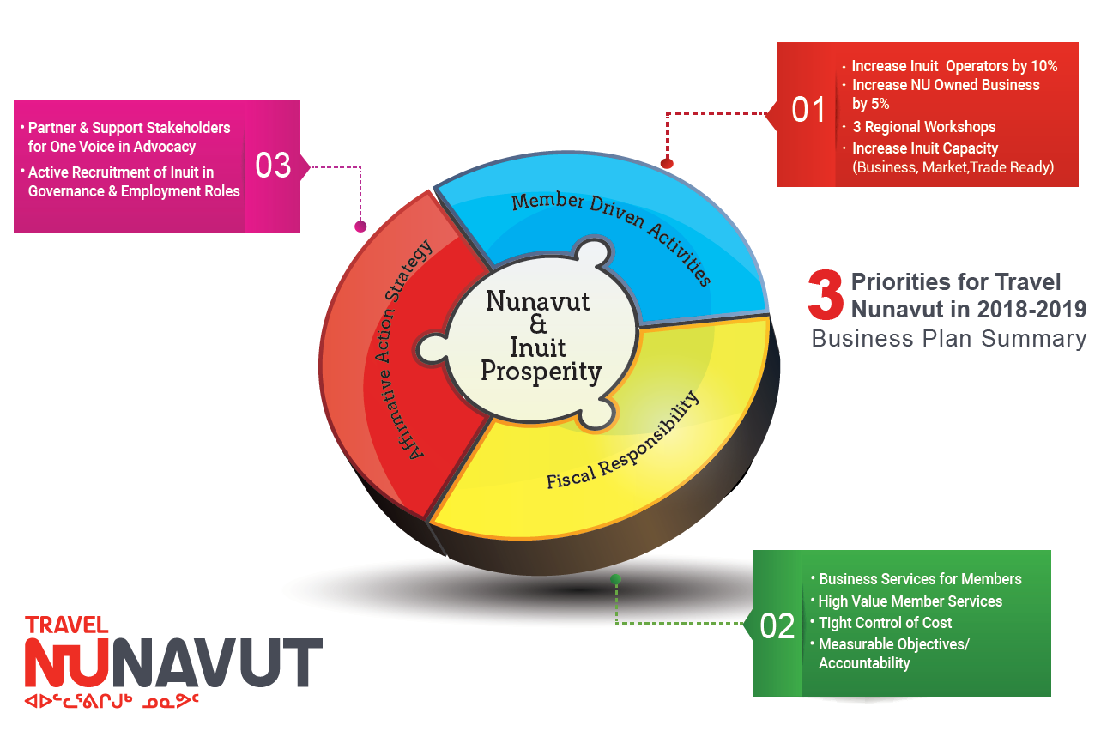

Slide 10
Input & Ideas: Top Priorities
We welcome input and ideas from all of our members.
Contact the office or any of the Board members.
We will continue with the implementation of our three priorities.
Kevin Kelly, the CEO of Travel Nunavut will report further on our progress within his presentation.

