Slide 1

For the Members of Travel Nunavut
Group Benefit Solutions
Leanne Willie
Employee Benefit Consultant
HUB International Insurance Brokers
Winnipeg, MB Office
Notes:
Good morning, My name is Leanne Willie and I work as employee benefits consultant for HUB International. First I would like to thank Travel Nunavut for reaching out to HUB to add Employee Benefits to the member offering but more important giving me the opportunity to come here to present to you today. This is my time up here and it is simply beautiful.
There is a brochure and a form for a request to a quote. We will be reviewing this later in the presentation and if it end up being something that you are interested in I can get the quote done while I am here until Wednesday. We also have some draws to make so please complete the ballot as well.
Now by a show of how many of you currently have a benefit plan in place whether if just for yourself or for you and your employees?
How many of you either owners or work for a company that has 10 or more employees.
Great, now I have understanding of my audience and how I can may be able to help you today regarding employee benefits.

Slide 2
Agenda
About HUB
Your HUB Employee Benefits Team
Employee Benefits Overview
HUB Complete Program
Questions
Contact Information
Notes:
Today’s agenda will be telling you a little bit more about HUB for those of have not had the opportunity to work with us yet.
Who your employee benefits team will be at HUB There is a lot of support behind me at the office but I was the lucky one to be able represent the team here today. Many of them wanted to come with me for sure.
Then I will do an overview of Employee Benefits and what is offered in a typical benefit plan followed by a program that we have designed for businesses like yourself.
Please feel free to ask questions throughout or I will give you an opportunity at the end.

Slide 3


About HUB

Slide 4






About HUB
400+
locations in North America
Top 5
Global Broker
11,000+
employees
1,000,000+
clients
92%
client retention
$12 Billion+
in premium
Notes:
As some of you may know already working with HUB on the other lines of business we offer, you are in the center of a vast network of experts who will help you reach your and your company's goals and employee benefits is no different.
One thing I would like to point out on this client that HUB has 92% client retention. HUB works strong at ensuring we offer our clients excellent customer service and keep providing innovated solutions to for you to remain competitive in the market place.
We like to make sure you have a peace of mind that matters most that you will be protected no matter what line of business you are looking at. We can help create a tailored insurance solution for your company that puts you in control. Just like the liability insurance that Eric will be going over, we now can help you focus on protecting your number on asset within your company which is yourself and your employees.
HUB is rapidly spreading its footprints across Northern America operating in every region and Canada’s North is no exception. I work with several different companies of all sizes in the north to ensure they remain competitive against their competition.

Slide 5
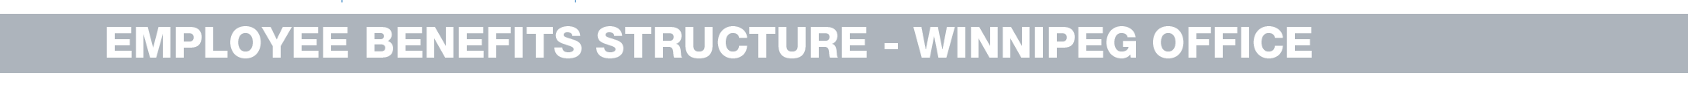
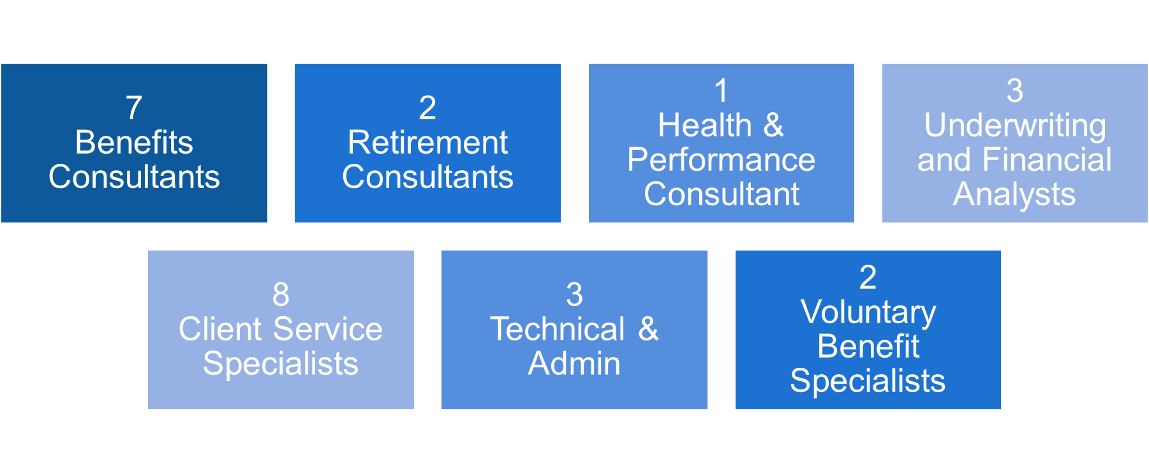

Our Employee Benefit Team
Notes:
I have a team in our Winnipeg office that supports me to ensure you with the service and support needed. We will also have a designated toll-free number for you to reach our designated customer service specialist that will be working with my on your accounts.
Another part that is unique to our office is that we have inhouse underwriting team and financial analysis that complete the own independent analysis of every renewal that we receive. Many time we are doing negotiations with the carrier on our clients behalf. We also have specialist in the retirement and wellness sector. Based on the team that we have there is a wealth of knowledge and expertise we have you covered.
If I don’t have the answer (which does not happen often) I have a team to go to.

Slide 6

Why are Employee Benefits Important to Your Business
Why consider an Employee Benefits Program
  Attracting and Retaining Key Talent
  Tax Effective Compensation
  Employee Goodwill
  Increase Morale
    - Help employee stay motivated
  Healthier Employees
Notes:
If I ask some of you a question that have benefits in place. Why did you put a benefit plan in place??
Typically the number one answer if to attract and retain client. Finding a good employee and hanging onto them can be vital part of running a successful business.
It doesn’t hurth that you are able to deduct the premiums as a business expense with pre-tax dollars.
Some business owners assume that they know what their employees want with regard to benefits. When considering offering a new benefit or changing an existing benefit, why not ask your employees what would have the biggest impact for them? You may be surprised at the answers you receive. Have you asked your employees lately what to they want??
Another advantage of offering benefits is the boosting of employee morale. By understanding and addressing the needs of your workforce, it’s likely that employees will be dedicated and take their jobs more seriously.
Showing that you care about your workers is a natural way to increase their loyalty and often to get their best work in return. Nothing can put a damper on productivity quicker than a bad attitude. By providing adequate benefits, you can help keep your employees happy.

Slide 7
Average Spent on Benefits
72.5%
employers
spend more than 25% of payroll on benefits
Are you getting value from your investment?
Notes:
Almost 73% of respondents spend more than 25% of payroll costs on Benefits according to the most recent survey.
Reality is that Benefits are not cheap for your company
Employee benefits remain a critical part of the relationship between employers and employees. In addition to serving as an important financial safety net, benefits also act as a recruitment and retention tool. Benefits represent a significant percentage of total employee compensation.
In addition to employee benefits the new tend that is also happening is Wellness Initiatives. More than 3 in 5 organizations 63% have budgets devoted to wellness and this is only expected to increase over the years.
Each company must weigh the cost vs. benefit and the return on investment when considering offering any group benefits options to employees
When we put a plan in place we also make sure it is design and priced to be sustainable for now and in the future. You don’t want to give the kitchen sick when you implement and then after their first renewal need to take it away. Salary and then reduce it…would not do this right.
Stats from International Foundation of Employee Benefits Plan survey.

Slide 8

Our Partnership
Implementation
Service
Strategy
We are
fully independent with complete access to the market
Notes:
When you partner with us I like to stay you get the whole meal deal and more.
We are your independent consultant that works exclusively for you as the middle man between you and the carriers. You basically hire an expert and everything we do is at the best interest of you and your company.
We work with all the major carrier such as GWL, SunLIfe and ENCON to name a few that you might be familiar with as I know they supportive of the business here.
HUB will work through and support you through the entire process as well as ongoing support.

Slide 9
Benefits Strategy
Benefits Strategy
Communications
Competitiveness
Expenses
Risk Management
Coverage & Contractual Provisions
Notes:
When developing a benefit strategy for you, we look at all of these components.
For example to ensure you remain competitive, we might need to do benchmarking of your plan which is comparing against other companies in the same industry and similar size. Example you might want to be adding vision onto your plan. When we compare against other company confirm nobody else offers you can then make the decision is this worth the money to add or add it giving you the competitive edge.
When selecting the appropriate carrier to work with we don’t just look at the lowest price we ensure their expenses, coverage and contractual provisions supported to the rates they quote. They don’t ‘ just try to buy your business and then jack up the rates at the first renewal.
We help to communicate with you employee as this is very important they under their coverages.

Slide 10
Managing Risk
Do you know what your risks are?
How much they could cost you?
How are they being managed today?
We have the expertise to identify and mitigate your risks.
Notes:
As part of Benefit Strategy at HUB we can help identify businesses or individuals on how to prepare for the unexpected and manage their risks.
Some organizations fall into the trap of managing risk by the likelihood of the event, while not fully considering cost exposure.
The risks we tend to see in the market would be gaps with the disability policies, Prescription Drug Plans within benefit program and Travel Health Coverage
As part of your Benefits Strategy we could help with reviewing the potential risks areas and developing cost effective solutions.
A lot of time you don’t realize the risk exposure and the cost impact to your company until an event happens.
Example. Extension of benefits policy for someone going off on LTD. Do you continue to maintain coverage for Health and Dental or is there a policy in place.

Slide 11

The Basic: Typical Employee Benefits Program
  Life Insurance
  Dependent Life Insurance
  Accidental Death & Dismemberment
  Short Term Disability
  Long Term Disability
  Health
  Dental
  Travel
  Other
Notes:
By offering comprehensive employee benefits that can help employers not only attract and retain talent but also boost overall worker morale while reducing employee absenteeism and stress.
The traditional benefit plan would include When I meet with clients we review their needs etc.
Life Benefit – Flat or 1X Annual Salary
Dependent Life – some carries this is a mandatory benefit that needs to be included. Offes $5,000-10,000 benefit.
Short Term Disability – EI program that offers min benefit. Not enough for higher income earners so companies look at add this benefit. If you offer this program through your company you may qualify for a reduction on your EI premiums
Long Term Disability – there is options available for this benefit.
Health – paramedicals massage, Chirpractor, prescription drugs etc.
Dental –
Travel – if you or your employees travel outside of the country lots you might also want to consider Business Travel. Most plans have a stability clause 60 days business (explain what that is) built in on their group plan but if they have to travel for work we can help with a policy to reduce the stability period.

Slide 12

The Basic: Other Benefits
  Employee and Family Assistance Program
  Critical Illness
  Personal Health Care Spending Account (PHSP)
  Wellness Programs
  Voluntary Benefits
Notes:
Here is a list of other benefits that you can include under your benefit plan. Some of the insurance companies that we work automatically include the Employee and Family Assistance program.
This is a program that is very helpful to promote the work/life balance for the employees.
Critical Illness is also becoming a lot more popular to include on the plan. Most of us know someone that has been diagnosed with or suffered a from a critical illness such as Cancer, Stroke or Heart A
ttack to name a couple. This coverage can supplement the coverage provided through your health, life or even disability plans giving an extra layer of financial protection. If you are diagnosed with one of the covered conditions defined within the plan, this benefit will pay a one‑time, lump‑sum
cash benefit tax-free that you can use in any manner you wish.
Personal Health Care Spending Account can also be used alone or as a complement to an existing benefit plan. It provides the flexibility and freedom to spend the benefit dollars on whichever expenses are incurred. Example, instead of putting vision coverage under the benefit plan, some of my company include $200 PHSP.

Slide 13
How is the Cost of a Benefit Plan is determined
  Demographics (gender, age, salary, occupation)
  Size of Group
  Industry
  Plan Design
  Usage of a plan
Notes:
The cost of benefit plan is determined by the following
Demographics – This is not like when you turn age 55 and get discounts because you are senior . The older you are the more you have to pay. So a group with 5 employees over the age 40 (and yes II would be in that group) rates would be higher than a group 30 year olds. This is why sometimes it is good to have blend to make the average age come down.
Size of Group- This is kinda like economy of sales The more you have coming on a tour I would imagine the better the price gets per person. Similar in the group pricing, the more employees you have in order to spread the greater risk the better the pricing becomes. So a group of 4 employees could be paying higher than a group with 20 employees at the beginning.
Industry – also plays a role in the pricing. In the insurance language they call it white collar vs blue collar or you can think office staff vs staff in the field that would have a greater risk of getting injured.
Plan Design – as I stated before when looking at the plan we help to navigate and design to ensure you are putting a plan that is not only priced on your budget today but for the future. We don’t have a crystal ball to see what the future holds but do know what some of the major drivers are for the plan. Example vision and orthodontics are big ticket items that tend to increase the usage of a plan if you have lots of families.
HUB has developed a program that has provided an aggregate solution that dedicated to similarly sized companies, By doing this we can offer protection against cost fluctuations by spreading out risk and providing rate stability.

Slide 14
HUB Complete for Small Business
We have designed an employee benefits package for small businesses (2-10) employees
Simple, cost-effective offering tailored to the needs and budget of small businesses
  Three plan alternatives
  100% family content allowed
  Disability included in all plans
  Seasonal Employees covered as long as they work 8 months of the year
  Independent Contract Employees eligible
Notes:
We saw a new in the small to medium market and developed a program that has options of different levels of benefits to help satisfy your employees but still protecting the bottom line for you. This is also my area of expertise and what a majority of my clients are that I handle.
We had recognized that it could be very overwhelming or challenging to find the ideal benefits package
HUB Complete is a employee benefits package program that is exclusive to our company for small business with 2-10 employees that does not currently have any coverage in place.
Two key component of this plan for some of you would be that is could cover seasonal employees as long as they work 8 months of the year
as well as independent contractors that are working exclusively for your company would be eligible for the Bronze and Silver plan design only.

Slide 15
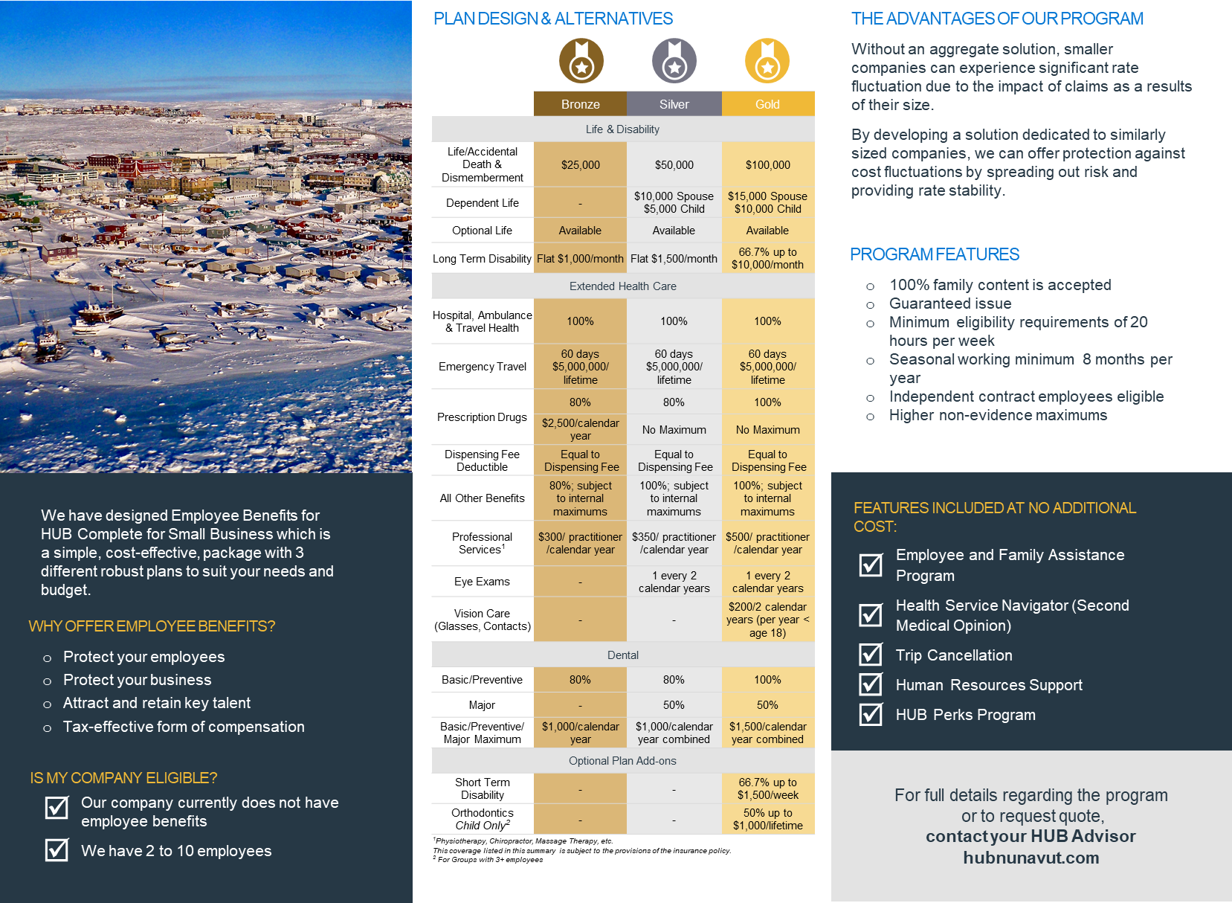
Notes:
You have a copy of this brochure outlining the three different plan designs Bronze Silver and Gold. Under the gold plan design there is a couple plan design add-ons that you can select such at Short Term Disability any size of group and Orthodontic coverage for groups of 3 lives of more .
Add feature at no additional cost Employee and Family Assistance Program along with the others that are listed.

Slide 16
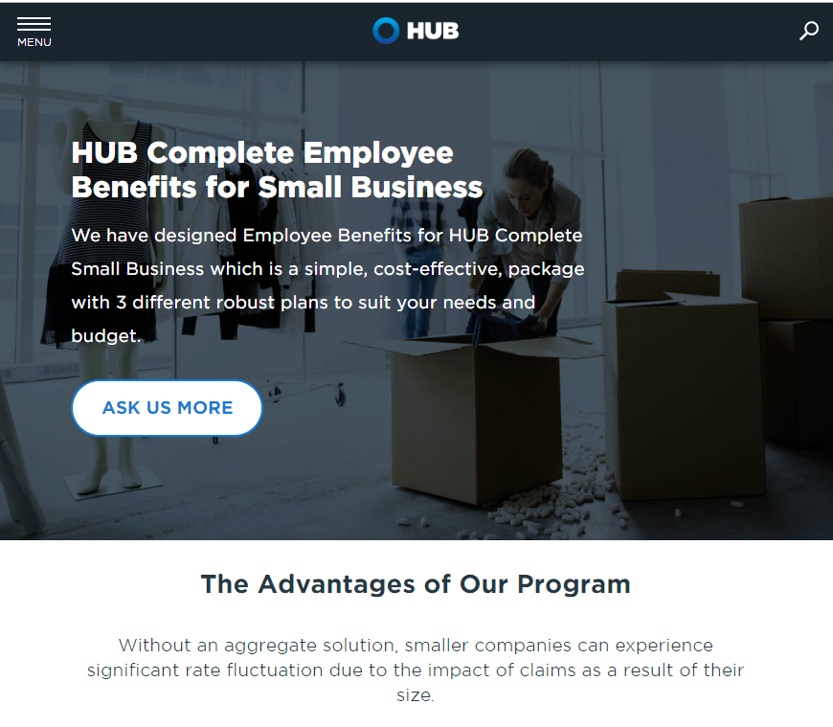
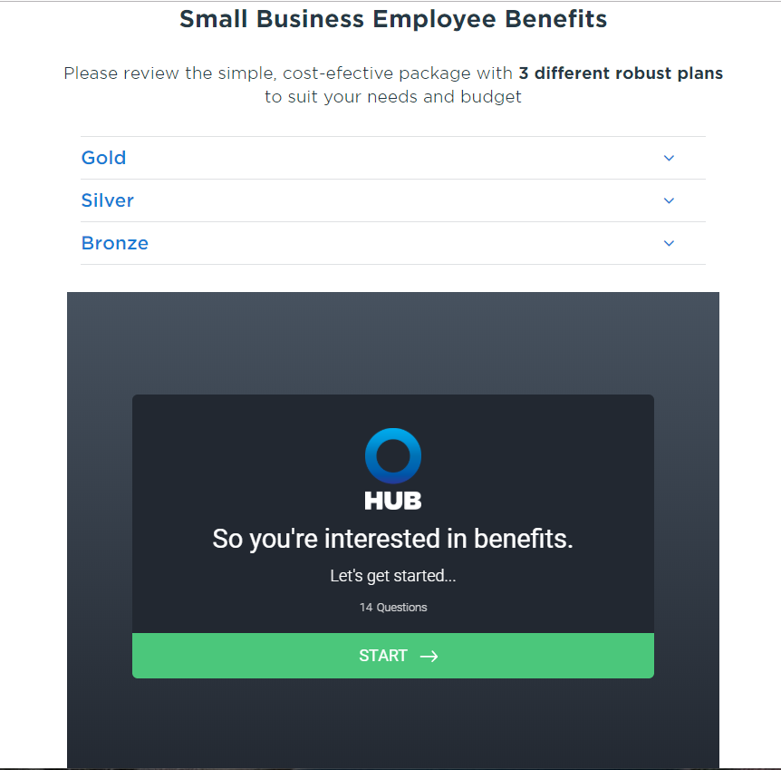
HUB Complete for Small Business www.hubinternational.com/hubcompletebenefits
Notes:
I have provided you a sheet to complete if you are interested in obtaining quote or you can visit our website for further information and complete the form online.
This is only one of the many solutions that we can offer. We work with all different sizes for groups from small to large companies with thousands of employees.
Depending on your situation we will help you navigate to the appropriate plan. lFor those of you who would not qualify for this program either because you currently have coverage in place or more than 10 employees, we can also still help assist with your employee benefit program.

Slide 17
Employee Benefits for Groups with Existing Coverage
Complete a Benefit Plan Review in order to identify Benefit Strategies and work with you to find a solution
AOR/ATR
Transfer
Collect
Current Plan Info
Develop Strategy
Deliver / Execute Value
Notes:
HUB works with company's to help develop a benefit strategy. We first like to learn more about your company and goals you wish to achieve for your organization. The next step would be completing a benefit review plan to help find a solution and ensure everything is aligned. This is a process that does take some but in the end it is worth the investment.

Slide 18

Take This To-GO
I’d like you to take the following from this presentation, if you get nothing else out of it…
Notes:
I know that I have provided you with lots of information today. I just want to leave you with this one thought
Regardless of your size of group, if you are startup company, established business that has potential to grow, we have a solution for you
HUB realize that implementing a group benefit plan for the first time can be intimidating and not to mention time consuming. HUB will be there to help you through the process the entire way with support of me and the team.
I will be here until Wednesday morning if you would like to meet to discuss further or receive a quote that I could get done within in the day for the HUB complete program.
I look forward to working with you all.

Slide 19
Questions
For any additional information regarding Group Benefits contact
Leanne Willie
Employee Benefits Consultant
Office: 1-204-984-9464
Fax: 204-984-9460
sbcomplete@hubinternational.com
www.hubnunavut.com

Slide 20
Together, we’ll tailor a solution to address the issues today and in the future
Let’s get started!
Notes:
Let’s protect not only your business but as well you and your employees.

